Slide 1
Electronic Devices and Circuits Lecture-8
CSE 223
Prepared by
Ipshita Tasnim Raha
Lecturer (Provisional)
Dept. of CSE
Varendra University

Slide 2
Operational Amplifier (Op-Amp)

Slide 3
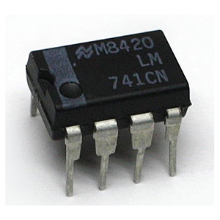
Operational Amplifier
An operational amplifier (or an op-amp) is an integrated circuit (IC) that operates as a voltage amplifier. It is a differential amplifier that amplifies the difference of voltages applied to its two input terminals (differential input), and provides a single ended output.
These amplifiers are called "operation" amplifiers because they were initially designed as an effective device for performing arithmetic operations in an analog circuit. The op-amp has many other applications in signal processing, measurement, and instrumentation.
Prepared by Ipshita Tasnim Raha
Notes:
https://www.youtube.com/watch?v=lACEHw9D7eA&list=PLMjaJoGgWV1keJY9g3rbRaJG4mOj1Dn_Z

Slide 4
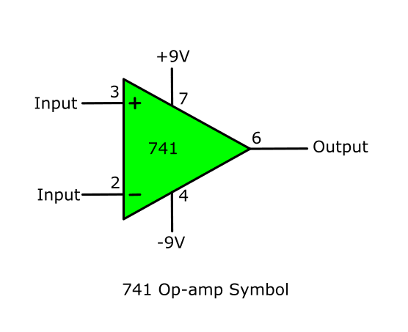
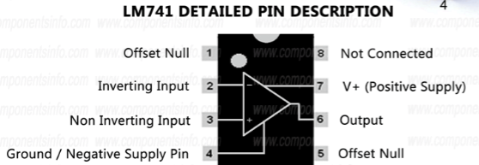
Symbol & Terminals
Prepared by Ipshita Tasnim Raha

Slide 5
Op-Amp Application
1. Several operation
Addition
Subtraction
Integration
differentiation etc.
2. Active filter
3. Oscillator
4. Waveform convertor
5. ADC & DAC convertors
6. Voltage follower
7. Voltage comparator
Prepared by Ipshita Tasnim Raha

Slide 6
Op-Amp terminals
An OP-AMP has a two input terminal, one output terminal and two supply voltage terminals.
The input terminal marked with negative (-) sign is called as an inverting terminal .If we connect the input signal to this terminal then the amplified output signal is 180º out of phase with respect to input.
The input terminal marked with positive (+) sign is called as Non-Inverting terminal. If the input is applied to this pin then the amplified output is in phase with the input.
+V_{s} (positive supply) & –V_{s} (Negative supply) are power supply or biasing voltage.
Offset null is used to nullify the offset voltage and pin no 8 is dummy pin.
Prepared by Ipshita Tasnim Raha

Slide 7
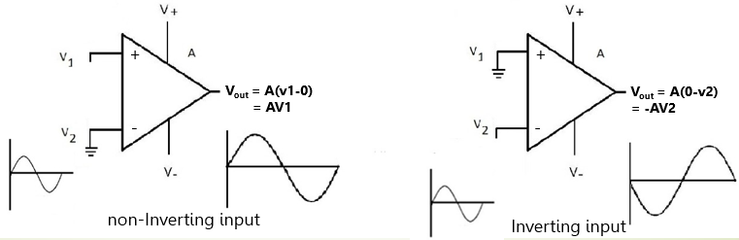
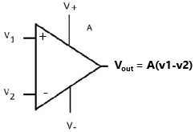
Inverting & Non-Inverting input
Prepared by Ipshita Tasnim Raha

Slide 8
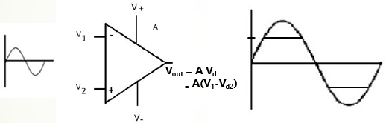
Power Supply (+V_{s ,}-V_{s} )
V_{d} (differential input signal)
Let, vd = 1mV
So, Vout=Avd= 1*10⁵=100V [the value of gain typically ranges from 10⁵ - 10⁸]
Prepared by Ipshita Tasnim Raha

Slide 9
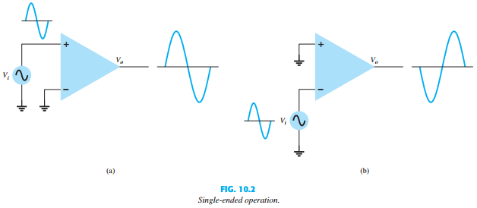
OP-AMP input modes
1. Single ended mode : If the input signal is applied to only one of the inputs and the other input terminal is connected to ground it is said to be operating in single ended mode.
Prepared by Ipshita Tasnim Raha

Slide 10
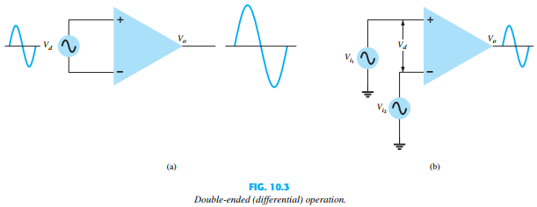
OP-AMP input modes
2. Differential mode/double ended: In differential mode ,two opposite polarity signal are applied to the two inputs of op amp. The difference between the input signal is amplified appears at the output
Prepared by Ipshita Tasnim Raha

Slide 11
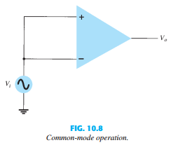
OP-AMP input modes
3. Common mode: In the common mode of operation, the same input signal is applied to both the input terminals. Ideally a zero voltage should be produced by the op amp.
Prepared by Ipshita Tasnim Raha

Slide 12
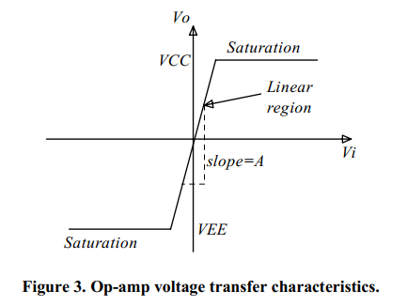
Op-Amp voltage transfer characteristics
The graph that relates the output voltage to the input voltage is called the voltage transfer curve and is fundamental in designing and understanding amplifier circuits.
The voltage transfer curve of the op-amp is shown below
Prepared by Ipshita Tasnim Raha

Slide 13
Common-mode and Differential-mode Signals:
The importance of a differential amplifier (DA) lies in the fact that the outputs are proportional to the difference between the two input signals. Thus the circuit can be used to amplify the difference between the two input signals or amplify only one input signal simply by grounding the other input. The input signals to a Differential Amplifier (DA) are defined as:
(i) Common-mode signals (ii) Differential-mode signals
Prepared by Ipshita Tasnim Raha

Slide 14
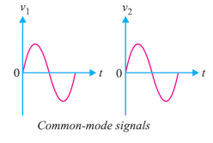
Common-mode and Differential-mode Signals:
(i) Common-mode signals : When the input signals to a DA are in phase and exactly equal in amplitude, they are called common-mode signals. The common-mode signals are rejected (not amplified) by the differential amplifier. It is because a differential amplifier amplifies the difference between the two signals (v1 – v2) and for common-mode signals, this difference is zero. In common-mode operations, v1 = v2.
The voltage gain of DA operating in common-mode is called common mode voltage gain and is denoted by A_{CM.}
Ideally A_{CM} = 0
Prepared by Ipshita Tasnim Raha

Slide 15
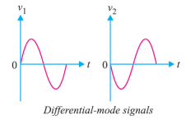
Common-mode and Differential-mode Signals:
(ii) Differential-mode signals. When the input signals to a DA are 180° out of phase and exactly equal in amplitude, they are called differential-mode signals. The differential-mode signals are amplified by the differential amplifier. It is because the difference in the signals is twice the value of each signal. For differential-mode signals, v1 = –v2.
The voltage gain of a DA operating in differential mode is called differential-mode voltage gain and is denoted by A_{DM}
Prepared by Ipshita Tasnim Raha

Slide 16
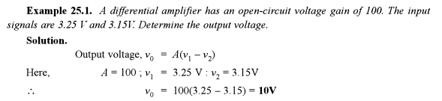
Math Problem
Prepared by Ipshita Tasnim Raha

Slide 17
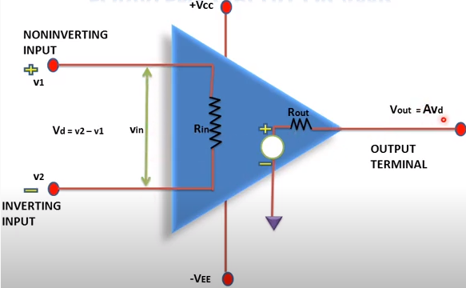
Op-Amp Equivalent Circuit
Prepared by Ipshita Tasnim Raha
Notes:
Reference book: VK Mehta, PG: 690

Slide 18
Characteristics of Ideal op-amp
Infinite (∞) voltage gain. A_{DM} = infinite (theoretically)
Input impedance, R_{i} = ∞
Zero output impedance, R₀ =0
Slew rate = ∞ [Slew rate is the maximum rate at which an amplifier can respond to the sudden change of input level]
CMRR = ∞ [The op amp common-mode rejection ratio (CMRR) is the ratio of the differential-mode gain to common-mode gain ]
Bandwidth = ∞
Prepared by Ipshita Tasnim Raha

Slide 19

Common-mode Rejection Ratio (CMRR):
A differential amplifier should have high differential voltage gain (A_{DM}) and very low common mode voltage gain (A_{CM}). The ratio A_{DM} /A_{CM} is called common-mode rejection ratio (CMRR). That is,
CMRR = A_{DM}/A_{CM}
Very often, the CMRR is expressed in decibels (dB). The decibel measure for CMRR is given by,
Importance of CMRR:
The CMRR is the ability of a DA to reject the common-mode signals. The larger the CMRR, the better the DA is at eliminating common-mode signals.
Prepared by Ipshita Tasnim Raha

Slide 20
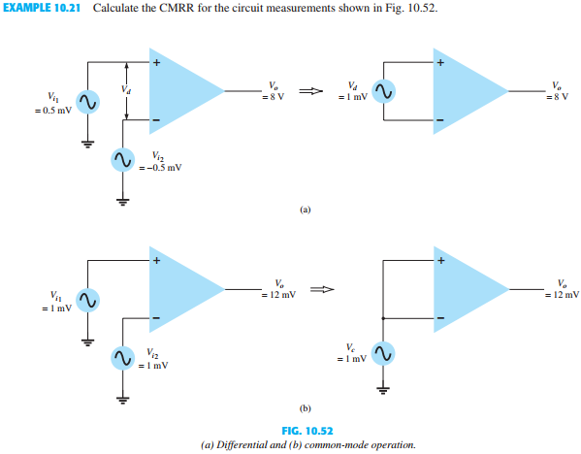
Math Problem
Prepared by Ipshita Tasnim Raha

Slide 21
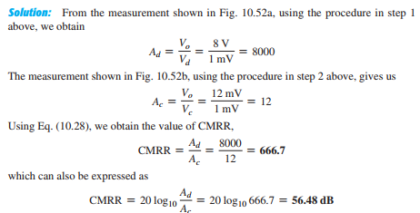
Math Problem
Prepared by Ipshita Tasnim Raha

Slide 22
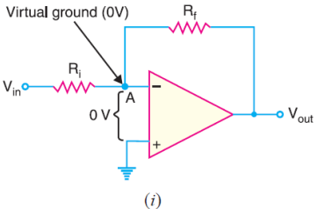
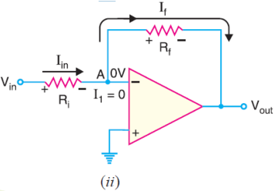
Virtual Ground concept
An OP-amp has an infinite input impedance. This means that there is zero current at the inverting input. If there is zero current through the input impedance, then there must be no voltage drop between the inverting and non-inverting inputs. Therefore, the inverting and non-inverting terminals will be at same potential. This means that the voltage at the inverting input (–) is zero because the other input (+) is grounded. The 0V at the inverting input terminal is referred to as virtual ground. The point A is said to be at virtual ground because it is at 0V but is not physically connected to the ground (VA = 0V).
Prepared by Ipshita Tasnim Raha

Slide 23
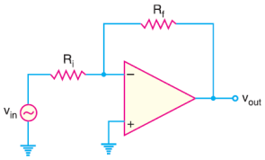
Inverting Amplifier
An Op-Amp can be operated as an inverting amplifier. An input signal vin is applied through input resistor Ri to the minus input (inverting input). The output is fed back to the same minus input through feedback resistor Rf. The plus input (non-inverting input) is grounded. The resistor Rf provides the negative feedback. Since the input signal is applied to the inverting input (–), the output will be inverted as compared to the input. Hence the name inverting amplifier.
Prepared by Ipshita Tasnim Raha

Slide 24
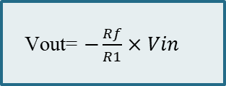
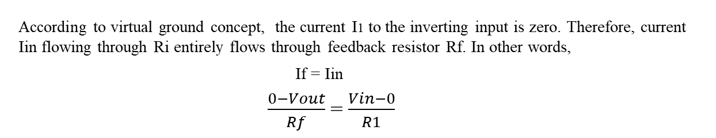
Voltage gain
According to virtual ground concept, the current I1 to the inverting input is zero. Therefore, current Iin flowing through Ri entirely flows through feedback resistor Rf. In other words,
If = Iin
$\frac{0−Vout}{Rf}$ = $\frac{Vin−0}{R1}$
Vout= $−\frac{Rf}{R1}×Vin$
Prepared by Ipshita Tasnim Raha

Slide 25
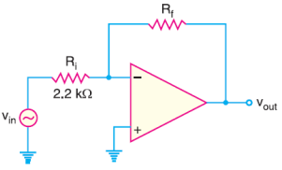
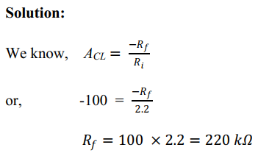
Math Problem
Example 1: Given the OP-amp configuration in Figure, determine the value of Rf required to produce a closed-loop voltage gain of –100.
Prepared by Ipshita Tasnim Raha

Slide 26
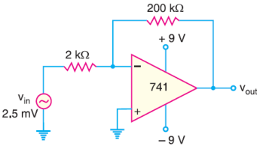
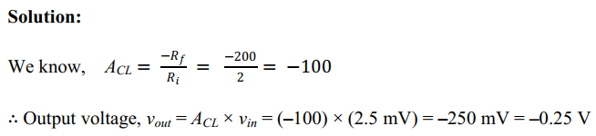
Math Problem
Example 2: Determine the output voltage for the given circuit.
Prepared by Ipshita Tasnim Raha

Slide 27
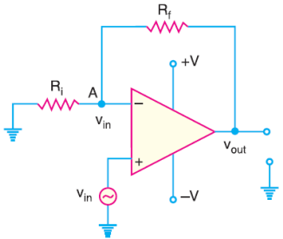
Non-inverting Amplifier
There are times when we wish to have an output signal of the same polarity as the input signal. In this case, the OP-amp is connected as non-inverting amplifier. The input signal is applied to the non-inverting input (+). The output is applied back to the input through the feedback circuit formed by feedback resistor Rf and input resistance Ri. This produces negative feedback in the circuit. Here Ri is grounded. Since the input signal is applied to the non-inverting input (+), the output signal will be non-inverted that is, the output signal will be in phase with the input signal.
Prepared by Ipshita Tasnim Raha

Slide 28
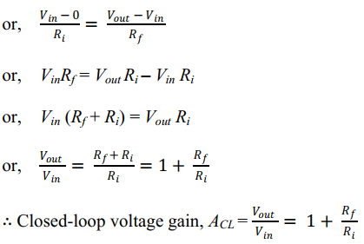
Voltage gain
Two terminals of an Op-Amp remain at same potential. Therefore, the potential at point A is the same as Vin.
Since the input impedance of OP-amp is very high, all of the current that flows through Rf also flows through Ri. Keeping these things in mind, we have, Voltage across Ri = Vin – 0 Voltage across Rf = Vout – Vin
Now, Current through Ri = Current through Rf
Prepared by Ipshita Tasnim Raha

Slide 29
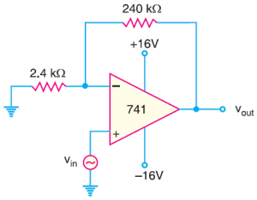
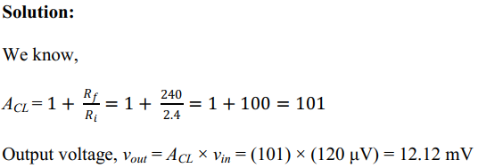
Math Problems
Example 1: Calculate the output voltage from the non-inverting amplifier circuit of the following circuit for an input of 120 μV.
Prepared by Ipshita Tasnim Raha

Slide 30
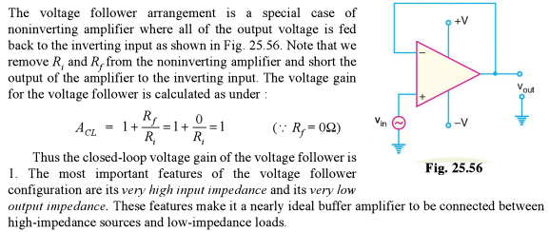
Voltage Follower/ Voltage Buffer
Prepared by Ipshita Tasnim Raha
Notes:
Reference book: VK Mehta, PG: 699

Slide 31
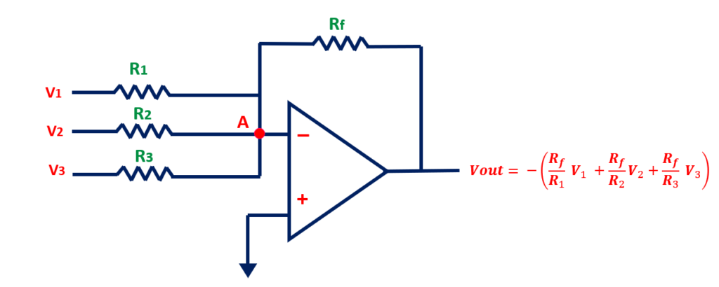
Summing Amplifiers
The circuit shows a three-input summing amplifier circuit, which provides a means of algebraically summing (adding) three voltages, each multiplied by a constant-gain factor
Prepared by Ipshita Tasnim Raha
Notes:
Reference book: VK Mehta, PG: 699

Slide 32
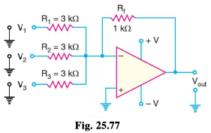
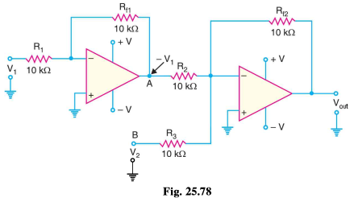
Math 1
Math 2
Prepared by Ipshita Tasnim Raha
Notes:
Reference book: VK Mehta, PG: 711

Slide 33
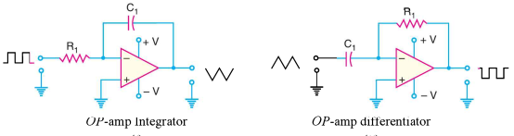

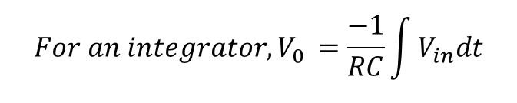
OP-Amp Integrators & Differentiators
$${For an integrator, V}_{0 }=\frac{−1}{RC}\int{V_{in}dt}$$
For a differentiator, $V_{0}=−RC\frac{dV_{in}}{dt}$
Prepared by Ipshita Tasnim Raha

Slide 34
Thanks!
Any questions?

